Slide 1
How to Convert a Context-Free Grammar to Greibach Normal Form
Roger L. Costello
August 16, 2014

Slide 2
Objective
This mini-tutorial will answer these questions:
  What is Greibach Normal Form?

Slide 3
Objective
This mini-tutorial will answer these questions:
  What is Greibach Normal Form?
  What are the benefits of having a grammar in Greibach Normal Form?

Slide 4
Objective
This mini-tutorial will answer these questions:
  What is Greibach Normal Form?
  What are the benefits of having a grammar in Greibach Normal Form?
  What algorithm can be used to convert a context-free grammar to Greibach Normal Form?

Slide 5
What is Greibach Normal Form?
A context-free grammar is in Greibach Normal Form if the right-hand side of each rule has one terminal followed by zero or more non-terminals:
A → aX
zero or more non-terminal symbols
one terminal symbol

Slide 6
Example of a grammar in
Greibach Normal Form
S → aB | bA
A → a | aS | bAA
B → b | bS | aBB
Every right-hand side consists of exactly one terminal followed by zero or more non-terminals.

Slide 7
Example of a grammar not in
Greibach Normal Form
terminal at end is not allowed
S → aBc
B → b
Not in Greibach Normal Form

Slide 8

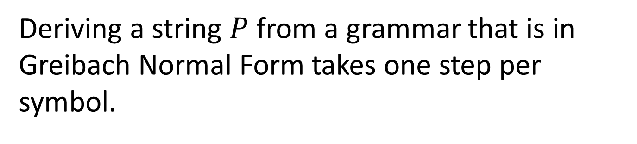
What are the benefits of
Greibach Normal Form?
Deriving a string $P$ from a grammar that is in Greibach Normal Form takes one step per symbol.
$$\#derivation steps = |P|$$

Slide 9
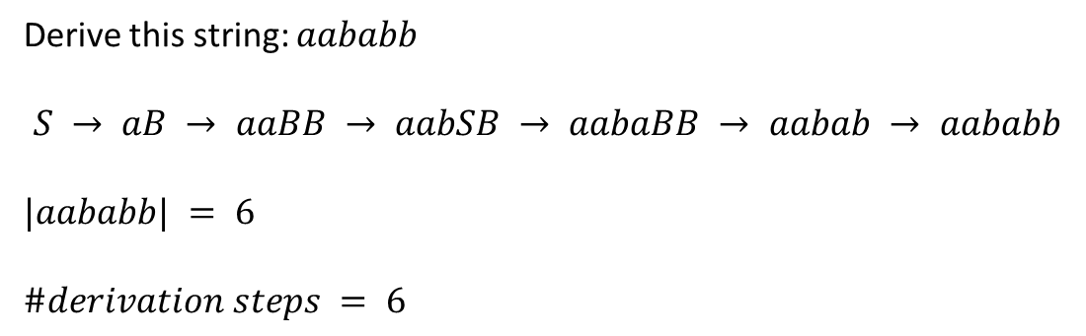
Example derivation
Grammar in Greibach Normal Form
S → aB | bA
A → a | aS | bAA
B → b | bS | aBB
Derive this string: $aababb$
$$S → aB → aaBB → aabSB → aabaBB → aabab → aababb$$
$$|aababb| = 6$$
$$\#derivation steps = 6$$

Slide 10
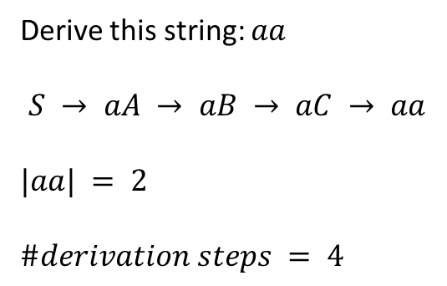
Contrast to a grammar that’s not in Greibach Normal Form
Grammar not in Greibach Normal Form
S → aA
A → B
B → C
C → a
Derive this string: $aa$
$$S → aA → aB → aC → aa$$
$$|aa| = 2$$
$$\#derivation steps = 4$$

Slide 11
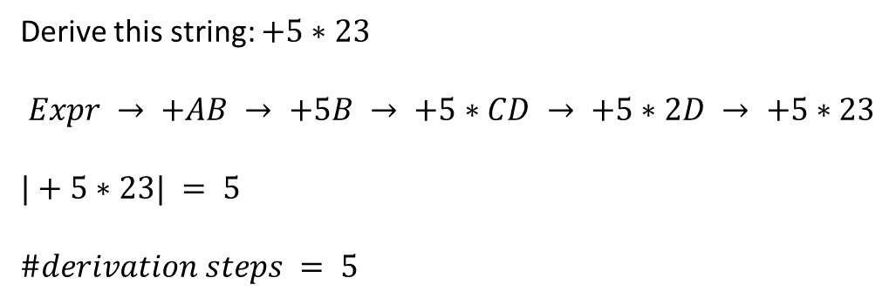
Greibach Normal Form is a
Prefix Notation
Grammar in Greibach Normal Form
Expr → +AB
A → 5
B → *CD
C → 2
D → 3
Derive this string: $+5∗23$
$$Expr → +AB → +5B → +5∗CD → +5∗2D → +5∗23$$
$$|+5∗23| = 5$$
$$\#derivation steps = 5$$

Slide 12
Benefits of Greibach Normal Form
Strings can be quickly parsed.
Expressions can be efficiently evaluated.

Slide 13
Every grammar has an equivalent grammar in Greibach normal form
To every ε-free context-free grammar we can find an equivalent grammar in Greibach normal form.

Slide 14
Grammar and its equivalent
Greibach Normal Form grammar
S → aBC
B → b
C → c
S → aBc
B → b
convert
Not Greibach Normal Form
Greibach Normal Form

Slide 15
Grammar and its equivalent
Greibach Normal Form grammar
S → Bc
B → b
S → bC
C → c
convert
Not Greibach Normal Form
Greibach Normal Form

Slide 16
Algorithm
We have seen a couple simple examples of converting grammars to Greibach Normal Form.
They didn’t reveal a systematic approach to doing the conversion.
The following slides show a systematic approach (i.e., algorithm) for doing the conversion.

Slide 17
But first …
Before we examine the algorithm, we need to understand two concepts:
  Chomsky Normal Form
  Left-recursive rules

Slide 18
Chomsky Normal Form
We will see that the algorithm requires the grammar be converted to Chomsky Normal Form.
A context-free grammar is in Chomsky Normal Form if each rule has one of these forms:
  X → a
  X → YZ
That is, the right-hand side is either a single terminal or two non-terminals.
See my tutorial on how to convert a context-free grammar to Chomsky normal form: http://xfront.com/formal-languages/Transforming-Context-Free-Grammars-to-Chomsky-Normal-Form.pptx

Slide 19
Left-recursive rules
The algorithm requires that the grammar have no left-recursive rules.
This is a left-recursive rule: A_{k} → A_{k}α | β
The alternative (β) allows a derivation to “break out of” the recursion.
Every left-recursive rule must have an alternative (β) that allows breaking out of the recursion.

Slide 20
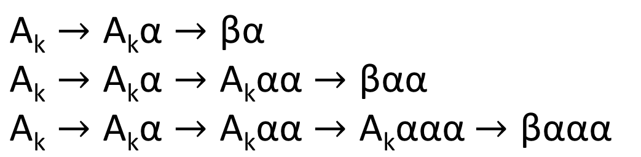
Algorithm to eliminate left-recursion
Let’s see how to eliminate the left-recursion in this rule: A_{k} → A_{k}α | β
The rule generates this language: βα^{n}, n≥1
To see this, look at a few derivations:
$$\text{A}\text{k}→\text{A}\text{k}\text{α}→\text{βα}$$
$$\text{A}\text{k}→\text{A}\text{k}\text{α}→\text{A}\text{k}\text{αα}→\text{βαα}$$
$\text{A}\text{k}→\text{A}\text{k}\text{α}→\text{A}\text{k}\text{αα}→\text{A}\text{k}\text{ααα}$ $→\text{βααα}$

Slide 21
Eliminate left-recursion
We want to eliminate the left-recursion in this rule: A_{k} → A_{k}α | β
And we know the rule produces βα^{n}
We can easily generate α^{n} with this rule:
A_{n+1} → αA_{n+1} | α
(Assume the grammar has “n” rules. So A_{n+1}
is a new rule that we just created.)

Slide 22
How to eliminate left-recursion
The language βα^{n} can, as we’ve seen, be generated using a left-recursive rule:
A_{k} → A_{k}α | β
But the language can also be generated using these rules:
A_{k} → βA_{n+1}
A_{n+1} → αA_{n+1} | α
With those two rules we have eliminated the left recursion.

Slide 23
Multiple left-recursive alternatives
Of course, A_{k} may have multiple alternatives that are left-recursive:
A_{k} → A_{k}α₁ | A_{k}α₂ | … | A_{k}α_{r}
And A_{k} may have multiple other alternatives:
A_{k} → β₁ | β₂ | … | β_{s}
So A_{k} may generate:
  β₁ followed by a string X: β₁X X={α₁,…,α_{r}}⁺
  …
  β_{s} followed by a string X: β_{s}α X={α₁,…,α_{r}}⁺

Slide 24
Rule to generate {α₁,…, α_{r}}⁺
We need rules to generate a string X:
A_{n+1} → α_{i} i = 1..r
A_{n+1} → α_{i} A_{n+1} i = 1..r

Slide 25
Rule to generate {α₁,…, α_{r}}⁺
And we need a rule to generate β₁A_{n+1},…,β_{s}A_{n+1} :
A_{k} → β_{i} A_{n+1} i = 1..s

Slide 26
Beautiful definition of how to eliminate left-recursion
Replace this left-recursive rule:
A_{k} → A_{k}α₁ | A_{k}α₂ | … | A_{k}α_{r} | β₁ | β₂ | … | β_{s}
By these rules:
A_{k} → β_{i} A_{n+1} i = 1..s
A_{n+1} → α_{i} i = 1..r
A_{n+1} → α_{i} A_{n+1} i = 1..r

Slide 27
Here’s the algorithm to convert a grammar to Greibach Normal Form
First, convert the grammar rules to Chomsky Normal Form. After doing so all the rules are in one of these forms:
  A_{i} → a, where “a” is a terminal symbol
  A_{i} → A_{j}A_{k}
The first form is in Greibach Normal Form, the second isn’t.
Then, order the rules followed by substitution:
  Convert the rules to ascending order: each rule is then of the form: A_{i} → A_{i+m}X
  After ordering, the highest rule will be in Greibach Normal Form: A_{n} → aX. The next-to-highest rule will depend on the highest-rule: A_{n-1} → A_{n}Y. Substitute A_{n} with its rhs:
  A_{n-1} → aXY. Now that rule is in Greibach Normal Form. Continue down the rules, doing the substitution.
rhs = right-hand side

Slide 28
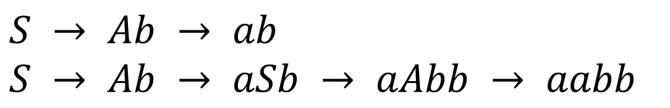
Apply the Algorithm to this Grammar
Convert this grammar, G, to Greibach Normal Form:
S → Ab
A → aS
A → a
First, what language does G generate?
Answer: L(G) = a^{n}b^{n}
Let’s derive a couple sentences to convince ourselves:
$$S → Ab → ab$$
$$S → Ab → aSb → aAbb → aabb$$

Slide 29
Step 1
Change the names of the non-terminal symbols to A_{i}
S → Ab
A → aS
A → a
A₁ → A₂b
A₂ → aA₁
A₂ → a
Change S to A₁,
A to A₂

Slide 30
Step 2
Convert the grammar to Chomsky Normal Form.
A₁ → A₂A₃
A₂ → A₄ A₁
A₂ → a
A₃ → b
A₄ → a
A₁ → A₂b
A₂ → aA₁
A₂ → a
Chomsky Normal Form

Slide 31
Step 3
Modify the rules so that the non-terminals are in ascending order. By “ascending order” we mean:
if A_{i} → A_{j}X is a rule, then i < j

Slide 32
k^{th} rule not in ascending order
Suppose the first k-1 rules are in ascending order but the k^{th} rule is not. Thus, A_{k} → A_{j}X is a rule and k ≥ j.

Slide 33
2 cases
We want to put this rule A_{k} → A_{j}X into ascending order.
We must deal with two cases:
  k > j
  k = j (left-recursive rule)

Slide 34
Case 1: k > j
A_{k} → A_{j}X
Replace this with the rhs of the rule(s) for A_{j}. If the resulting rule(s) is still not in ascending order, continue replacing until it is in ascending order.

Slide 35
Example
…
A₇ → A₁₀U
A₇ → A₈X
A₈ → A₁₅Y
A₉ → A₇Z
…
A₇ → A₁₀U
A₇ → A₈X
A₈ → A₁₅Y
A₉ → A₁₀UZ
A₉ → A₈XZ
These rules are in ascending order
But this is not in ascending order
Replace this with the rhs of A₇
Now replace this with the rhs of A₈. Repeat until A₉ is in ascending order.

Slide 36
Beautiful definition of how to modify A_{k} → A_{j}X, k > j
Let A_{j} be this rule:
A_{j} → Y₁ | … | Y_{m}
Replace the rule A_{k} → A_{j}X by these rules:
A_{k} → Y_{i}X i = 0..m
Each Y_{i} begins with either a terminal symbol or some A_{m} where j < m.
Recursively repeat the substitution for each Y_{i} that begins with A_{m} and k > m.

Slide 37
Avoid getting into a loop!
…
A₇ → A₇U
A₇ → A₈X
A₈ → A₁₅Y
A₉ → A₇Z
Suppose we replace A₇ with the rhs of this rule:
We then have this: A₉ → A₇UZ
We’re stuck in a loop!

Slide 38
Process A₇ before A₉
…
A₇ → A₇U
A₇ → A₈X
A₈ → A₁₅Y
A₉ → A₇Z
This rule is not in ascending order. Before processing A₉ we must process A₁ – A₈ (put them in ascending order). Earlier we showed how to eliminate left-recursion.

Slide 39
Worst Case: k-1 substitutions
A₁ → A₂X₁
A₂ → A₃X₂
A₃ → A₄X₃
A₄ → A₅X₄
A₅ → A₆X₄
A₆ → A₇X₅
A₇ → A₈X₆
A₈ → A₉X₇
A₉ → A₁X₈
Replace this with the rhs of A₁. Now we have A₉ → A₂X₁ so replace A₂ with the rhs of A₂. Now we have A₉ → A₃X₂X₁ so replace A₃ … and so forth.
In the worst case, for rule A_{k} we will need to make k-1 substitutions.

Slide 40
Apply Step 3 to our Grammar
Modify the rules with k > j:
A₁ → A₂A₃
A₂ → A₄ A₁
A₂ → a
A₃ → b
A₄ → a
Already in order: 1 < 2 and 2 < 4

Slide 41
Case 2: k = j
The grammar may have some left-recursive rules; that is, rules like this: A_{k} → A_{k}X
We want to eliminate the left-recursion.
See the earlier slides for how to eliminate left recursion.

Slide 42
Apply Case 1 and Case 2 processing to A₁, then A₂, then …
The previous slides for Step 3 might be a bit misleading. They seem to say: “First process all rules where k > j and then process all rules where k = j.” That is incorrect.
Start at A₁ and ensure it is in ascending order. Only after you’ve put A₁ in ascending order do you process A₂. And so forth.

Slide 43
Eliminate left recursion in our Grammar
Replace left-recursive rules:
A₁ → A₂A₃
A₂ → A₄ A₁
A₂ → a
A₃ → b
A₄ → a
No left-recursive rules

Slide 44
Step 4
Let A_{n} be the highest order variable (non-terminal).
Then the rhs of A_{n} must be a terminal symbol (otherwise the rhs would be a non-terminal symbol, A_{n} → A_{n+1}X and A_{n+1} would be the highest order variable).
The leftmost symbol on the rhs of any rule for A_{n-1} must be either A_{n} or a terminal symbol. If it is A_{n} then replace A_{n} with the rhs of the A_{n} rule(s). Repeat for A_{n-2}, A_{n-3}, …, A₁. After doing this we end up with rules whose rhs starts with a terminal symbol.

Slide 45
Beautiful definition of how to modify A_{n-1} → A_{n}X
Let A_{n} be this rule:
A_{n} → a₁Y₁ | … | a_{m}Y_{m}
Let A_{n-1} be this rule:
A_{n-1} → A_{n}X
Replace the rule A_{n-1} → A_{n}X by these rules:
A_{n-1} → a_{i}Y_{i}X i = 0..m

Slide 46
Apply Step 4 to our Grammar
Replace left-most non-terminals, working from A₄ to A₁:
A₁ → A₂A₃
A₂ → A₄ A₁
A₂ → a
A₃ → b
A₄ → a
A₁ → A₂A₃
A₂ → aA₁
A₂ → a
A₃ → b
A₄ → a
Replace A₂ by aA₁
A₁ → aA₁A₃
A₁ → aA₃
A₂ → aA₁
A₂ → a
A₃ → b
A₄ → a
Replace A₄ by a
Replace A₂ by a

Slide 47
Step 5
Change symbol names back to their original names.
A₁ → aA₁A₃
A₁ → aA₃
A₂ → aA₁
A₂ → a
A₃ → b
A₄ → a
S → aSA₃
S → aA₃
A → aS
A → a
A₃ → b
A₄ → a
Change A₁ to S,
A₂ to A

Slide 48
Grammar is now in
Greibach Normal Form
S → aSA₃
S → aA₃
A → aS
A → a
A₃ → b
A₄ → a
S → Ab
A → aS
A → a
Not in Greibach Normal Form
L(G) = a^{n}b^{n}
Greibach Normal Form
L(G) = a^{n}b^{n}

Slide 49
Unused rules
S → aSA₃
S → aA₃
A → aS
A → a
A₃ → b
A₄ → a
Cannot reach these rules from the start symbol, S. So remove them.

Slide 50
Grammar without unused rules
S → aSA₃
S → aA₃
A₃ → b
Still in Greibach Normal Form

Slide 51
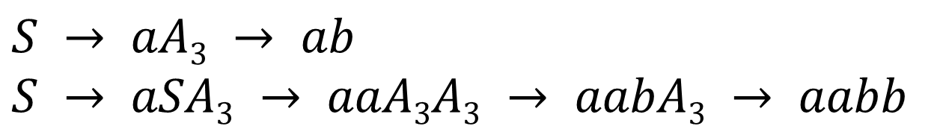
Verify the grammar generates a^{n}b^{n}
S → aSA₃
S → aA₃
A₃ → b
Let’s do a couple derivations to convince ourselves that it generates a^{n}b^{n}
$$S → aA3 → ab$$
$$S → aSA3 → aaA3A3 → aabA3 → aabb$$

Slide 52
Recap of the steps
Step 0: Determine the language that the grammar generates
Step 1: Change the non-terminal names to A_{i}
Step 2: Convert the grammar to Chomsky normal form
Step 3a: Modify the rules A_{k} → A_{j}X, k > j so that the leftmost non-terminal A_{j}, k ≤ j
Step 3b: Eliminate left-recursion
Step 4: If the leftmost symbol on the rhs of rule A_{n-1} is A_{n}, replace that A_{n} with the rhs of the A_{n} rules. Then do Step 4 for A_{n-2}. Repeat until at A₁.
Step 5: Change the non-terminal names back to their original names.
Step 6: Remove unused rules.
Step 7: Verify that the new grammar generates the same language as the original language.

Slide 53
Minimize work
Step 1 says:
Change the non-terminal names to A_{i}
That is just another way of saying that we are to give the symbol names an ordering. Choose the ordering wisely as it can impact the amount of work needed to do the conversion.

Slide 54
Good ordering for this grammar?
S → AB
A → a
B → b
Change S to A₁
A to A₂,
B to A₃
Change S to A₃
A to A₂,
B to A₁
A₁ → A₂A₃
A₂ → a
A₃ → b
A₃ → A₂A₁
A₂ → a
A₁ → b

Slide 55
Compare the orderings
A₁ → A₂A₃
A₂ → a
A₃ → b
This rule is in ascending order
A₃ → A₂A₁
A₂ → a
A₁ → b
This rule is not in ascending order so we will have to work to get it into ascending order

Slide 56
Lesson Learned
To minimize the amount of work needed to convert a grammar to Greibach Normal Form, assign a lower number to X and a higher number to Y if there is a rule X → Y. For example, change X to A₁ and Y to A₂.

Slide 57
Convert this grammar
For the following grammar find an equivalent grammar in Greibach Normal Form :
S → S + A A → AB B → (S) B → b
S → A A → B B → a B → c

Slide 58
Step 0
Determine the language that the grammar generates
S → S + A A → AB B → (S) B → b
S → A A → B B → a B → c
The grammar generates the language containing simple arithmetic expressions with addition and multiplication (in the guise of concatenation)

Slide 59
Derive a + bc + b
S → S + A A → AB B → (S) B → b
S → A A → B B → a B → c
a + bc + b is generated by:
S → S + A
→ S + b
→ S + A + b
→ S + AB + b
→ S + Ac + b
→ S + Bc + b
→ S + bc + b
→ A + bc + b
→ B + bc + b
→ a + bc + b

Slide 60
Step 1
Change the non-terminal names to A_{i}
S → S + A A → AB B → (S) B → b
S → A A → B B → a B → c
Change S to A₁,
A to A₂, B to A₃
A₁ → A₁ + A₂ A₂ → A₂A₃ A₃ → (A₁) A₃ → b
A₁ → A₂ A₂ → A₃ A₃ → a A₃ → c

Slide 61
Step 2
Convert the grammar to Chomsky normal form
See next slide →

Slide 62
Convert the grammar to Chomsky normal form:
A₁ → A₁ + A₂ A₂ → A₂A₃ A₃ → (A₁) A₃ → b
A₁ → A₂ A₂ → A₃ A₃ → a A₃ → c
A₁ → A₁A₄A₂ A₂ → A₂A₃ A₃ → A₅A₁A₆ A₃ → b
A₁ → A₂ A₂ → A₃ A₃ → a A₃ → c
A₄ → + A₅ → (
A₆ → )
A₁ → A₁A₇ A₂ → A₂A₃ A₃ → A₅A₈ A₃ → b
A₁ → A₂ A₂ → A₃ A₃ → a A₃ → c
A₄ → + A₅ → (
A₇ → A₄A₂ A₆ → )
A₈ → A₁A₆
Continued →

Slide 63
Convert the grammar to Chomsky normal form:
A₁ → A₁A₇ A₂ → A₂A₃ A₃ → A₅A₈ A₃ → b
A₁ → A₂ A₂ → A₃ A₃ → a A₃ → c
A₄ → + A₅ → (
A₇ → A₄A₂ A₆ → )
A₈ → A₁A₆
A₁ → A₁A₇ A₂ → A₂A₃ A₃ → A₅A₈ A₃ → b
A₁ → A₂ A₂ → A₅A₈ A₃ → a A₃ → c
A₄ → + A₂ → a A₅ → (
A₇ → A₄ A₂ A₂ → b A₆ → )
A₈ → A₁A₆
Continued →

Slide 64
A₁ → A₁A₇ A₂ → A₂A₃ A₃ → A₅A₈ A₃ → b
A₁ → A₂ A₂ → A₅A₈ A₃ → a A₃ → c
A₄ → + A₂ → a A₅ → (
A₇ → A₄ A₂ A₂ → b A₆ → )
A₈ → A₁A₆
A₁ → A₁A₇ A₂ → A₂A₃ A₃ → A₅A₈ A₃ → b
A₁ → A₂A₃ A₂ → A₅A₈ A₃ → a A₃ → c
A₁ → A₅A₈ A₂ → a A₅ → (
A₁ → a A₂ → b A₆ → )
A₁ → b A₈ → A₁A₆
A₄ → +
A₇ → A₄A₂
Now it’s in Chomsky Normal Form

Slide 65
Step 3
Process the rules, from lowest to highest, putting them into ascending order
A₁ → A₁A₇ A₂ → A₂A₃ A₃ → A₅A₈ A₃ → b
A₁ → A₂A₃ A₂ → A₅A₈ A₃ → a A₃ → c
A₁ → A₅A₈ A₂ → a A₅ → (
A₁ → a A₂ → b A₆ → )
A₁ → b A₈ → A₁A₆
A₄ → +
A₇ → A₄A₂

Slide 66
A₁ → A₁A₇ A₂ → A₂A₃ A₃ → A₅A₈ A₃ → b
A₁ → A₂A₃ A₂ → A₅A₈ A₃ → a A₃ → c
A₁ → A₅A₈ A₂ → a A₅ → (
A₁ → a A₂ → b A₆ → )
A₁ → b A₈ → A₁A₆
A₄ → +
A₇ → A₄ A₂
A₁ → A₂A₃A₉ A₂ → A₂A₃ A₃ → A₅A₈ A₃ → b
A₁ → A₅A₈ A₉ A₂ → A₅A₈ A₃ → a A₃ → c
A₁ → A₂A₃ A₂ → a A₅ → (
A₁ → A₅A₈ A₂ → b A₆ → )
A₁ → a A₈ → A₁A₆
A₁ → b
A₄ → +
A₇ → A₄ A₂
A₉ → A₇
A₉ → A₇A₉

Slide 67
A₁ → A₂A₃A₉ A₂ → A₂A₃ A₃ → A₅A₈ A₃ → b
A₁ → A₅A₈ A₉ A₂ → A₅A₈ A₃ → a A₃ → c
A₁ → A₂A₃ A₂ → a A₅ → (
A₁ → A₅A₈ A₂ → b A₆ → )
A₁ → a A₈ → A₁A₆
A₁ → b
A₄ → +
A₇ → A₄ A₂
A₉ → A₇
A₉ → A₇A₉
A₁ → A₂A₃A₉ A₂ → A₅A₈A₁₀ A₃ → A₅A₈ A₃ → b
A₁ → A₅A₈ A₉ A₂ → aA₁₀ A₃ → a A₃ → c
A₁ → A₂A₃ A₂ → bA₁₀ A₅ → (
A₁ → A₅A₈ A₂ → A₅A₈ A₆ → )
A₁ → a A₂ → a A₈ → A₁A₆
A₁ → b A₂ → b
A₄ → + A₁₀ → A₃
A₇ → A₄A₂ A₁₀ → A₃A₁₀
A₉ → A₇
A₉ → A₇A₉

Slide 68
A₁ → A₂A₃A₉ A₂ → A₅A₈A₁₀ A₃ → A₅A₈ A₃ → b
A₁ → A₅A₈ A₉ A₂ → aA₁₀ A₃ → a A₃ → c
A₁ → A₂A₃ A₂ → bA₁₀ A₅ → (
A₁ → A₅A₈ A₂ → A₅A₈ A₆ → )
A₁ → a A₂ → a A₈ → A₁A₆
A₁ → b A₂ → b
A₄ → + A₁₀ → A₃
A₇ → A₄A₂ A₁₀ → A₃A₁₀
A₉ → A₇
A₉ → A₇A₉
A₁ → A₂A₃A₉ A₂ → A₅A₈A₁₀ A₃ → A₅A₈ A₃ → b
A₁ → A₅A₈ A₉ A₂ → aA₁₀ A₃ → a A₃ → c
A₁ → A₂A₃ A₂ → bA₁₀ A₅ → (
A₁ → A₅A₈ A₂ → A₅A₈ A₆ → )
A₁ → a A₂ → a A₈ → A₁A₆
A₁ → b A₂ → b
A₄ → + A₁₀ → A₃
A₇ → +A₂ A₁₀ → A₃A₁₀
A₉ → A₇
A₉ → A₇A₉

Slide 69
A₁ → A₂A₃A₉ A₂ → A₅A₈A₁₀ A₃ → A₅A₈ A₃ → b
A₁ → A₅A₈A₉ A₂ → aA₁₀ A₃ → a A₃ → c
A₁ → A₂A₃ A₂ → bA₁₀ A₅ → (
A₁ → A₅A₈ A₂ → A₅A₈ A₆ → )
A₁ → a A₂ → a A₈ → A₁A₆
A₁ → b A₂ → b
A₄ → + A₁₀ → A₃
A₇ → +A₂ A₁₀ → A₃A₁₀
A₉ → A₇
A₉ → A₇A₉
A₁ → A₂A₃A₉ A₂ → A₅A₈A₁₀ A₃ → A₅A₈ A₃ → b
A₁ → A₅A₈A₉ A₂ → aA₁₀ A₃ → a A₃ → c
A₁ → A₂A₃ A₂ → bA₁₀ A₅ → (
A₁ → A₅A₈ A₂ → A₅A₈ A₆ → )
A₁ → a A₂ → a A₈ → A₂A₃A₆
A₁ → b A₂ → b A₈ → A₅A₈A₆
A₄ → + A₁₀ → A₃ A₈ → A₂A₆
A₇ → +A₂ A₁₀ → A₃A₁₀ A₈ → A₅A₆
A₉ → A₇ A₈ → aA₆
A₉ → A₇A₉ A₈ → bA₆

Slide 70
A₁ → A₂A₃A₉ A₂ → A₅A₈A₁₀ A₃ → A₅A₈ A₃ → b
A₁ → A₅A₈A₉ A₂ → aA₁₀ A₃ → a A₃ → c
A₁ → A₂A₃ A₂ → bA₁₀ A₅ → (
A₁ → A₅A₈ A₂ → A₅A₈ A₆ → )
A₁ → a A₂ → a A₈ → A₅A₈A₁₀A₃A₆
A₁ → b A₂ → b A₈ → aA₁₀A₃A₆
A₄ → + A₁₀ → A₃ A₈ → bA₁₀A₃A₆
A₇ → +A₂ A₁₀ → A₃A₁₀ A₈ → A₅A₈A₃A₆
A₉ → A₇ A₈ → aA₃A₆
A₉ → A₇A₉ A₈ → bA₃A₆
A₈ → A₅A₈A₆
A₈ → A₂A₆
A₈ → A₅A₆
A₈ → aA₆
A₈ → bA₆

Slide 71
A₁ → A₂A₃A₉ A₂ → A₅A₈A₁₀ A₃ → A₅A₈ A₃ → b
A₁ → A₅A₈A₉ A₂ → aA₁₀ A₃ → a A₃ → c
A₁ → A₂A₃ A₂ → bA₁₀ A₅ → (
A₁ → A₅A₈ A₂ → A₅A₈ A₆ → )
A₁ → a A₂ → a A₈ → (A₈A₁₀A₃A₆
A₁ → b A₂ → b A₈ → aA₁₀A₃A₆
A₄ → + A₁₀ → A₃ A₈ → bA₁₀A₃A₆
A₇ → +A₂ A₁₀ → A₃A₁₀ A₈ → A₅A₈A₃A₆
A₉ → A₇ A₈ → aA₃A₆
A₉ → A₇A₉ A₈ → bA₃A₆
A₈ → A₅A₈A₆
A₈ → A₂A₆
A₈ → A₅A₆
A₈ → aA₆
A₈ → bA₆

Slide 72
A₁ → A₂A₃A₉ A₂ → A₅A₈A₁₀ A₃ → A₅A₈ A₃ → b
A₁ → A₅A₈A₉ A₂ → aA₁₀ A₃ → a A₃ → c
A₁ → A₂A₃ A₂ → bA₁₀ A₅ → (
A₁ → A₅A₈ A₂ → A₅A₈ A₆ → )
A₁ → a A₂ → a A₈ → (A₈A₁₀A₃A₆
A₁ → b A₂ → b A₈ → aA₁₀A₃A₆
A₄ → + A₁₀ → A₃ A₈ → bA₁₀A₃A₆
A₇ → +A₂ A₁₀ → A₃A₁₀ A₈ → (A₈A₃A₆
A₉ → A₇ A₈ → aA₃A₆
A₉ → A₇A₉ A₈ → bA₃A₆
A₈ → A₅A₈A₆
A₈ → A₂A₆
A₈ → A₅A₆
A₈ → aA₆
A₈ → bA₆

Slide 73
A₁ → A₂A₃A₉ A₂ → A₅A₈A₁₀ A₃ → A₅A₈ A₃ → b
A₁ → A₅A₈A₉ A₂ → aA₁₀ A₃ → a A₃ → c
A₁ → A₂A₃ A₂ → bA₁₀ A₅ → (
A₁ → A₅A₈ A₂ → A₅A₈ A₆ → )
A₁ → a A₂ → a A₈ → (A₈A₁₀A₃A₆
A₁ → b A₂ → b A₈ → aA₁₀A₃A₆
A₄ → + A₁₀ → A₃ A₈ → bA₁₀A₃A₆
A₇ → +A₂ A₁₀ → A₃A₁₀ A₈ → (A₈A₃A₆
A₉ → A₇ A₈ → aA₃A₆
A₉ → A₇A₉ A₈ → bA₃A₆
A₈ → (A₈A₆
A₈ → A₂A₆
A₈ → A₅A₆
A₈ → aA₆
A₈ → bA₆

Slide 74
A₁ → A₂A₃A₉ A₂ → A₅A₈A₁₀ A₃ → A₅A₈ A₃ → b
A₁ → A₅A₈A₉ A₂ → aA₁₀ A₃ → a A₃ → c
A₁ → A₂A₃ A₂ → bA₁₀ A₅ → (
A₁ → A₅A₈ A₂ → A₅A₈ A₆ → )
A₁ → a A₂ → a A₈ → (A₈A₁₀A₃A₆
A₁ → b A₂ → b A₈ → aA₁₀A₃A₆
A₄ → + A₁₀ → A₃ A₈ → bA₁₀A₃A₆
A₇ → +A₂ A₁₀ → A₃A₁₀ A₈ → (A₈A₃A₆
A₉ → A₇ A₈ → aA₃A₆
A₉ → A₇ A₉ A₈ → bA₃A₆
A₈ → (A₈A₆
A₈ → A₂A₆
A₈ → (A₆
A₈ → aA₆
A₈ → bA₆

Slide 75
A₁ → A₂A₃A₉ A₂ → A₅A₈A₁₀ A₃ → A₅A₈ A₃ → b
A₁ → A₅A₈A₉ A₂ → aA₁₀ A₃ → a A₃ → c
A₁ → A₂A₃ A₂ → bA₁₀ A₅ → (
A₁ → A₅A₈ A₂ → A₅A₈ A₆ → )
A₁ → a A₂ → a A₈ → (A₈A₁₀A₃A₆
A₁ → b A₂ → b A₈ → aA₁₀A₃A₆
A₄ → + A₁₀ → A₃ A₈ → bA₁₀A₃A₆
A₇ → +A₂ A₁₀ → A₃A₁₀ A₈ → (A₈A₃A₆
A₉ → +A₂ A₈ → aA₃A₆
A₉ → A₇A₉ A₈ → bA₃A₆
A₈ → (A₈A₆
A₈ → A₂A₆
A₈ → (A₆
A₈ → aA₆
A₈ → bA₆

Slide 76
A₁ → A₂A₃A₉ A₂ → A₅A₈A₁₀ A₃ → A₅A₈ A₃ → b
A₁ → A₅A₈A₉ A₂ → aA₁₀ A₃ → a A₃ → c
A₁ → A₂A₃ A₂ → bA₁₀ A₅ → (
A₁ → A₅A₈ A₂ → A₅A₈ A₆ → )
A₁ → a A₂ → a A₈ → (A₈A₁₀A₃A₆
A₁ → b A₂ → b A₈ → aA₁₀A₃A₆
A₄ → + A₁₀ → A₃ A₈ → bA₁₀A₃A₆
A₇ → +A₂ A₁₀ → A₃A₁₀ A₈ → (A₈A₃A₆
A₉ → +A₂ A₈ → aA₃A₆
A₉ → A₇A₉ A₈ → bA₃A₆
A₈ → (A₈A₆
A₈ → A₂A₆
A₈ → (A₆
A₈ → aA₆
A₈ → bA₆

Slide 77
A₁ → A₂A₃A₉ A₂ → A₅A₈A₁₀ A₃ → A₅A₈ A₃ → b
A₁ → A₅A₈A₉ A₂ → aA₁₀ A₃ → a A₃ → c
A₁ → A₂A₃ A₂ → bA₁₀ A₅ → (
A₁ → A₅A₈ A₂ → A₅A₈ A₆ → )
A₁ → a A₂ → a A₈ → (A₈A₁₀A₃A₆
A₁ → b A₂ → b A₈ → aA₁₀A₃A₆
A₄ → + A₁₀ → A₅A₈ A₈ → bA₁₀A₃A₆
A₇ → +A₂ A₁₀ → a A₈ → (A₈A₃A₆
A₉ → +A₂ A₁₀ → b A₈ → aA₃A₆
A₉ → +A₂A₉ A₁₀ → c A₈ → bA₃A₆
A₁₀ → A₃A₁₀ A₈ → (A₈A₆
A₈ → A₂A₆
A₈ → (A₆
A₈ → aA₆
A₈ → bA₆

Slide 78
A₁ → A₂A₃A₉ A₂ → A₅A₈A₁₀ A₃ → A₅A₈ A₃ → b
A₁ → A₅A₈A₉ A₂ → aA₁₀ A₃ → a A₃ → c
A₁ → A₂A₃ A₂ → bA₁₀ A₅ → (
A₁ → A₅A₈ A₂ → A₅A₈ A₆ → )
A₁ → a A₂ → a A₈ → (A₈A₁₀A₃A₆
A₁ → b A₂ → b A₈ → aA₁₀A₃A₆
A₄ → + A₁₀ → (A₈ A₈ → bA₁₀A₃A₆
A₇ → +A₂ A₁₀ → a A₈ → (A₈A₃A₆
A₉ → +A₂ A₁₀ → b A₈ → aA₃A₆
A₉ → +A₂A₉ A₁₀ → c A₈ → bA₃A₆
A₁₀ → A₃A₁₀ A₈ → (A₈A₆
A₈ → A₂A₆
A₈ → (A₆
A₈ → aA₆
A₈ → bA₆

Slide 79
A₁ → A₂A₃A₉ A₂ → A₅A₈A₁₀ A₃ → A₅A₈ A₃ → b
A₁ → A₅A₈A₉ A₂ → aA₁₀ A₃ → a A₃ → c
A₁ → A₂A₃ A₂ → bA₁₀ A₅ → (
A₁ → A₅A₈ A₂ → A₅A₈ A₆ → )
A₁ → a A₂ → a A₈ → (A₈A₁₀A₃A₆
A₁ → b A₂ → b A₈ → aA₁₀A₃A₆
A₄ → + A₁₀ → (A₈ A₈ → bA₁₀A₃A₆
A₇ → +A₂ A₁₀ → a A₈ → (A₈A₃A₆
A₉ → +A₂ A₁₀ → b A₈ → aA₃A₆
A₉ → +A₂A₉ A₁₀ → c A₈ → bA₃A₆
A₁₀ → A₅A₈A₁₀ A₈ → (A₈A₆
A₁₀ → aA₁₀ A₈ → A₂A₆
A₁₀ → bA₁₀ A₈ → (A₆
A₁₀ → cA₁₀ A₈ → aA₆
A₈ → bA₆

Slide 80
A₁ → A₂A₃A₉ A₂ → A₅A₈A₁₀ A₃ → A₅A₈ A₃ → b
A₁ → A₅A₈A₉ A₂ → aA₁₀ A₃ → a A₃ → c
A₁ → A₂A₃ A₂ → bA₁₀ A₅ → (
A₁ → A₅A₈ A₂ → A₅A₈ A₆ → )
A₁ → a A₂ → a A₈ → (A₈A₁₀A₃A₆
A₁ → b A₂ → b A₈ → aA₁₀A₃A₆
A₄ → + A₁₀ → (A₈ A₈ → bA₁₀A₃A₆
A₇ → +A₂ A₁₀ → a A₈ → (A₈A₃A₆
A₉ → +A₂ A₁₀ → b A₈ → aA₃A₆
A₉ → +A₂A₉ A₁₀ → c A₈ → bA₃A₆
A₁₀ → (A₈A₁₀ A₈ → (A₈A₆
A₁₀ → aA₁₀ A₈ → A₂A₆
A₁₀ → bA₁₀ A₈ → (A₆
A₁₀ → cA₁₀ A₈ → aA₆
A₈ → bA₆
Done! Every rule is in ascending order. We started at A₁ and worked our way to A₁₀. Wow!

Slide 81
Step 4
Process the rules, from A₁₀ to A₁, putting them into Greibach Normal Form

Slide 82
A₁ → A₂A₃A₉ A₂ → A₅A₈A₁₀ A₃ → A₅A₈ A₃ → b
A₁ → A₅A₈A₉ A₂ → aA₁₀ A₃ → a A₃ → c
A₁ → A₂A₃ A₂ → bA₁₀ A₅ → (
A₁ → A₅A₈ A₂ → A₅A₈ A₆ → )
A₁ → a A₂ → a A₈ → (A₈A₁₀A₃A₆
A₁ → b A₂ → b A₈ → aA₁₀A₃A₆
A₄ → + A₁₀ → (A₈ A₈ → bA₁₀A₃A₆
A₇ → +A₂ A₁₀ → a A₈ → (A₈A₃A₆
A₉ → +A₂ A₁₀ → b A₈ → aA₃A₆
A₉ → +A₂A₉ A₁₀ → c A₈ → bA₃A₆
A₁₀ → (A₈A₁₀ A₈ → (A₈A₆
A₁₀ → aA₁₀ A₈ → A₂A₆
A₁₀ → bA₁₀ A₈ → (A₆
A₁₀ → cA₁₀ A₈ → aA₆
A₈ → bA₆
The rules A₁₀ - A₄ are already in Greibach Normal Form so our starting point is A₃.

Slide 83
A₁ → A₂A₃A₉ A₂ → A₅A₈A₁₀ A₃ → (A₈ A₃ → b
A₁ → A₅A₈A₉ A₂ → aA₁₀ A₃ → a A₃ → c
A₁ → A₂A₃ A₂ → bA₁₀ A₅ → (
A₁ → A₅A₈ A₂ → A₅A₈ A₆ → )
A₁ → a A₂ → a A₈ → (A₈A₁₀A₃A₆
A₁ → b A₂ → b A₈ → aA₁₀A₃A₆
A₄ → + A₁₀ → (A₈ A₈ → bA₁₀A₃A₆
A₇ → +A₂ A₁₀ → a A₈ → (A₈A₃A₆
A₉ → +A₂ A₁₀ → b A₈ → aA₃A₆
A₉ → +A₂A₉ A₁₀ → c A₈ → bA₃A₆
A₁₀ → (A₈A₁₀ A₈ → (A₈A₆
A₁₀ → aA₁₀ A₈ → A₂A₆
A₁₀ → bA₁₀ A₈ → (A₆
A₁₀ → cA₁₀ A₈ → aA₆
A₈ → bA₆

Slide 84
A₁ → A₂A₃A₉ A₂ → (A₈A₁₀ A₃ → (A₈ A₃ → b
A₁ → A₅A₈A₉ A₂ → aA₁₀ A₃ → a A₃ → c
A₁ → A₂A₃ A₂ → bA₁₀ A₅ → (
A₁ → A₅A₈ A₂ → A₅A₈ A₆ → )
A₁ → a A₂ → a A₈ → (A₈A₁₀A₃A₆
A₁ → b A₂ → b A₈ → aA₁₀A₃A₆
A₄ → + A₁₀ → (A₈ A₈ → bA₁₀A₃A₆
A₇ → +A₂ A₁₀ → a A₈ → (A₈A₃A₆
A₉ → +A₂ A₁₀ → b A₈ → aA₃A₆
A₉ → +A₂A₉ A₁₀ → c A₈ → bA₃A₆
A₁₀ → (A₈A₁₀ A₈ → (A₈A₆
A₁₀ → aA₁₀ A₈ → A₂A₆
A₁₀ → bA₁₀ A₈ → (A₆
A₁₀ → cA₁₀ A₈ → aA₆
A₈ → bA₆

Slide 85
A₁ → A₂A₃A₉ A₂ → (A₈A₁₀ A₃ → (A₈ A₃ → b
A₁ → A₅A₈A₉ A₂ → aA₁₀ A₃ → a A₃ → c
A₁ → A₂A₃ A₂ → bA₁₀ A₅ → (
A₁ → A₅A₈ A₂ → (A₈ A₆ → )
A₁ → a A₂ → a A₈ → (A₈A₁₀A₃A₆
A₁ → b A₂ → b A₈ → aA₁₀A₃A₆
A₄ → + A₁₀ → (A₈ A₈ → bA₁₀A₃A₆
A₇ → +A₂ A₁₀ → a A₈ → (A₈A₃A₆
A₉ → +A₂ A₁₀ → b A₈ → aA₃A₆
A₉ → +A₂A₉ A₁₀ → c A₈ → bA₃A₆
A₁₀ → (A₈A₁₀ A₈ → (A₈A₆
A₁₀ → aA₁₀ A₈ → A₂A₆
A₁₀ → bA₁₀ A₈ → (A₆
A₁₀ → cA₁₀ A₈ → aA₆
A₈ → bA₆

Slide 86
A₁ → (A₈A₁₀A₃A₉ A₂ → (A₈A₁₀ A₃ → (A₈ A₃ → b
A₁ → aA₁₀ A₃A₉ A₂ → aA₁₀ A₃ → a A₃ → c
A₁ → bA₁₀ A₃A₉ A₂ → bA₁₀ A₅ → (
A₁ → (A₈A₃A₉ A₂ → (A₈ A₆ → )
A₁ → aA₃A₉ A₂ → a A₈ → (A₈A₁₀A₃A₆
A₁ → bA₃A₉ A₂ → b A₈ → aA₁₀A₃A₆
A₁ → A₅A₈A₉ A₁₀ → (A₈ A₈ → bA₁₀A₃A₆
A₁ → A₂A₃ A₁₀ → a A₈ → (A₈A₃A₆
A₁ → A₅A₈ A₁₀ → b A₈ → aA₃A₆
A₁ → a A₁₀ → c A₈ → bA₃A₆
A₁ → b A₁₀ → (A₈A₁₀ A₈ → (A₈A₆
A₄ → + A₁₀ → aA₁₀ A₈ → A₂A₆
A₇ → +A₂ A₁₀ → bA₁₀ A₈ → (A₆
A₉ → +A₂ A₁₀ → cA₁₀ A₈ → aA₆
A₉ → +A₂A₉ A₈ → bA₆

Slide 87
A₁ → (A₈A₁₀A₃A₉ A₂ → (A₈A₁₀ A₃ → (A₈ A₃ → b
A₁ → aA₁₀A₃A₉ A₂ → aA₁₀ A₃ → a A₃ → c
A₁ → bA₁₀A₃A₉ A₂ → bA₁₀ A₅ → (
A₁ → (A₈A₃A₉ A₂ → (A₈ A₆ → )
A₁ → aA₃A₉ A₂ → a A₈ → (A₈A₁₀A₃A₆
A₁ → bA₃ A₉ A₂ → b A₈ → aA₁₀A₃A₆
A₁ → (A₈A₉ A₁₀ → (A₈ A₈ → bA₁₀A₃A₆
A₁ → A₂A₃ A₁₀ → a A₈ → (A₈A₃A₆
A₁ → A₅A₈ A₁₀ → b A₈ → aA₃A₆
A₁ → a A₁₀ → c A₈ → bA₃A₆
A₁ → b A₁₀ → (A₈A₁₀ A₈ → (A₈A₆
A₄ → + A₁₀ → aA₁₀ A₈ → A₂A₆
A₇ → +A₂ A₁₀ → bA₁₀ A₈ → (A₆
A₉ → +A₂ A₁₀ → cA₁₀ A₈ → aA₆
A₉ → +A₂A₉ A₈ → bA₆

Slide 88
A₁ → (A₈A₁₀A₃A₉ A₂ → (A₈A₁₀ A₃ → (A₈ A₃ → b
A₁ → aA₁₀A₃A₉ A₂ → aA₁₀ A₃ → a A₃ → c
A₁ → bA₁₀A₃A₉ A₂ → bA₁₀ A₅ → (
A₁ → (A₈A₃A₉ A₂ → (A₈ A₆ → )
A₁ → aA₃A₉ A₂ → a A₈ → (A₈A₁₀A₃A₆
A₁ → bA₃A₉ A₂ → b A₈ → aA₁₀A₃A₆
A₁ → (A₈A₉ A₁₀ → (A₈ A₈ → bA₁₀A₃A₆
A₁ → (A₈A₁₀A₃ A₁₀ → a A₈ → (A₈A₃A₆
A₁ → aA₁₀A₃ A₁₀ → b A₈ → aA₃A₆
A₁ → bA₁₀A₃ A₁₀ → c A₈ → bA₃A₆
A₁ → (A₈A₃ A₁₀ → (A₈A₁₀ A₈ → (A₈A₆
A₁ → aA₃ A₁₀ → aA₁₀ A₈ → A₂A₆
A₁ → bA₃ A₁₀ → bA₁₀ A₈ → (A₆
A₁ → A₅A₈ A₁₀ → cA₁₀ A₈ → aA₆
A₁ → a A₈ → bA₆
A₁ → b
A₄ → +
A₇ → +A₂
A₉ → +A₂
A₉ → +A₂A₉

Slide 89
A₁ → (A₈A₁₀A₃A₉ A₂ → (A₈A₁₀ A₃ → (A₈ A₃ → b
A₁ → aA₁₀A₃A₉ A₂ → aA₁₀ A₃ → a A₃ → c
A₁ → bA₁₀A₃A₉ A₂ → bA₁₀ A₅ → (
A₁ → (A₈A₃A₉ A₂ → (A₈ A₆ → )
A₁ → aA₃A₉ A₂ → a A₈ → (A₈A₁₀A₃A₆
A₁ → bA₃A₉ A₂ → b A₈ → aA₁₀A₃A₆
A₁ → (A₈A₉ A₁₀ → (A₈ A₈ → bA₁₀A₃A₆
A₁ → (A₈A₁₀A₃ A₁₀ → a A₈ → (A₈A₃A₆
A₁ → aA₁₀A₃ A₁₀ → b A₈ → aA₃A₆
A₁ → bA₁₀A₃ A₁₀ → c A₈ → bA₃A₆
A₁ → (A₈A₃ A₁₀ → (A₈A₁₀ A₈ → (A₈A₆
A₁ → aA₃ A₁₀ → aA₁₀ A₈ → A₂A₆
A₁ → bA₃ A₁₀ → bA₁₀ A₈ → (A₆
A₁ → (A₈ A₁₀ → cA₁₀ A₈ → aA₆
A₁ → a A₈ → bA₆
A₁ → b
A₄ → +
A₇ → +A₂
A₉ → +A₂
A₉ → +A₂A₉
All the rules are now in Greibach Normal Form!

