Slide 1
Transforming Context-Free Grammars to Chomsky Normal Form
Roger L. Costello
April 12, 2014

Slide 2
Objective
This mini-tutorial will answer these questions:
  What is Chomsky Normal Form?

Slide 3
Objective
This mini-tutorial will answer these questions:
  What is Chomsky Normal Form?
  Why is Chomsky Normal Form useful/relevant?

Slide 4
Objective
This mini-tutorial will answer these questions:
  What is Chomsky Normal Form?
  Why is Chomsky Normal Form useful/relevant?
  How can arbitrary context-free grammars be converted to Chomsky Normal Form?

Slide 5
Objective
This mini-tutorial will answer these questions:
  What is Chomsky Normal Form?
  Why is Chomsky Normal Form useful/relevant?
  How can arbitrary context-free grammars be converted to Chomsky Normal Form?
  Can we determine a priori how many steps it will take for a grammar to generate a string?

Slide 6
Objective
This mini-tutorial will answer these questions:
  What is Chomsky Normal Form?
  Why is Chomsky Normal Form useful/relevant?
  How can arbitrary context-free grammars be converted to Chomsky Normal Form?
  Can we determine a priori how many steps it will take for a grammar to generate a string?
  Is there a procedure for determining if a string is in the set of strings generated by a grammar?

Slide 7
But first, binary trees
Before defining Chomsky Normal Form, let’s talk a bit about binary trees.
Each node in a binary tree has zero, one, or two children.

Slide 8
Sample binary tree
S
A
a
B
C
D
c
d

Slide 9
Node with 2 children
S
A
a
B
C
D
c
d
This node has two children

Slide 10
Node with 1 child
S
A
a
B
C
D
c
d
This node has one child

Slide 11
Node with 0 children
S
A
a
B
C
D
c
d
This node has no children

Slide 12
Well studied
Binary trees have been well-studied.
Lots is known about them.

Slide 13
Specialized binary trees
There are specialized binary trees.
One such specialized binary tree requires each node have either zero or two children (no nodes with one child).

Slide 14
Sample specialized binary tree
S
A
B
C
D
Each node has either zero children or two children.

Slide 15
Full binary tree
Definition: A full binary tree is a binary tree in which each node has exactly zero or two children.

Slide 16
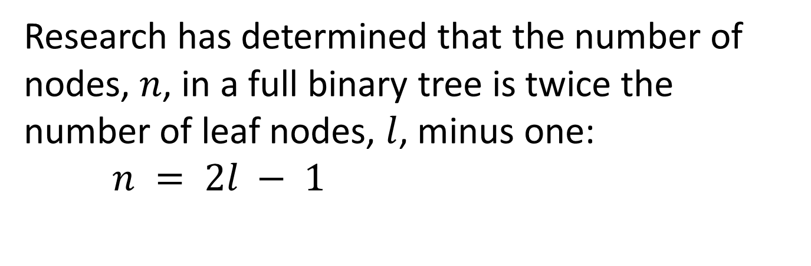
Number of nodes a full binary tree
Research has determined that the number of nodes, $n$, in a full binary tree is twice the number of leaf nodes, $l$, minus one:
$n = 2l − 1$
http://courses.cs.vt.edu/~cs3114/Fall09/wmcquain/Notes/T03a.BinaryTreeTheorems.pdf

Slide 17
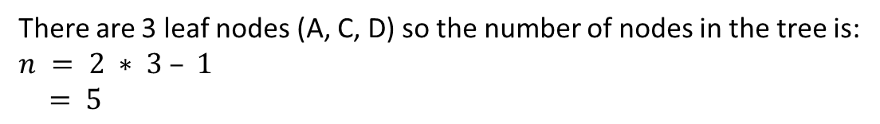
Calculate number of nodes in this full binary tree
S
A
B
C
D
There are 3 leaf nodes (A, C, D) so the number of nodes in the tree is:
$$n = 2 ∗ 3 – 1$$
$= 5$

Slide 18
Context-free grammar
Here is a context-free grammar:
S → AaBb
A → aB
B → b
Don’t know what a context-free grammar is? Check out my tutorial:
http://xfront.com/Context-free-grammars-are-a-subset-of-context-sensitive-grammars.pptx

Slide 19
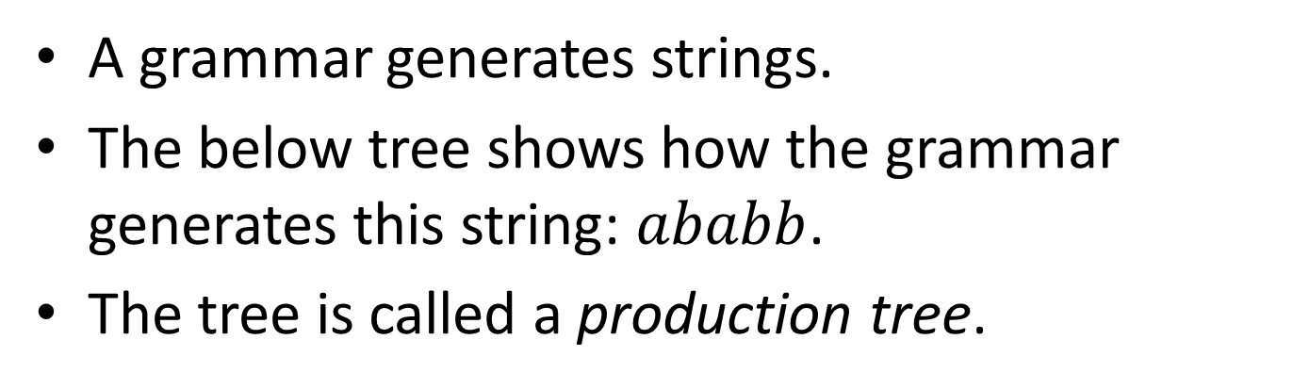
Production tree
A grammar generates strings.
The below tree shows how the grammar generates this string: $ababb$.
The tree is called a production tree.
S
A
a
a
B
B
b
b
b
S → AaBb
A → aB
B → b
grammar

Slide 20
Number of child nodes
S
A
a
a
B
B
b
b
b
This node has 4 child nodes

Slide 21
Number of child nodes
S
A
a
a
B
B
b
b
b
This node has 2 child nodes

Slide 22
Number of child nodes
This node has 1 child node
S
A
a
a
B
B
b
b
b

Slide 23
Number of child nodes
S
A
a
a
B
B
b
b
b
This node has 0 child nodes

Slide 24
Nodes have 0, 1, 2, or 4 child nodes
S
A
a
a
B
B
b
b
b

Slide 25
Terminology: arity
Arity is the maximum number of child nodes that a node in the tree may have.
The arity of the tree on the previous slide is 4.
Conversely, the arity of a binary tree is 2.

Slide 26
Not well-studied
Whereas binary trees are well-studied, trees of arbitrary arity are not so well studied.
For trees that have arbitrary arity it is hard to find nice, neat results.

Slide 27
Another context-free grammar
Here is a context-free grammar:
S → AB
A → a
B → b

Slide 28
Here is its production tree
S
A
B
b
a
S → AB
A → a
B → b
The production tree is a binary tree.

Slide 29
Arbitrary context-free grammars versus restricted context-free grammars
Arbitrary context-free grammars yield production trees that are not binary.
Grammars with rules which are restricted to no more than 2 symbols on the right-hand side have production trees that are binary trees.

Slide 30
Benefit of restricted grammar rules
There are benefits to grammars that are restricted to no more than 2 symbols on the right-hand side of each rule:
  Their production trees are binary trees, which are well-studied and lots of useful research results can be applied to such trees.

Slide 31
Let’s recap what we’ve learned
Binary trees consist of nodes that have
0, 1, or 2 child nodes.

Slide 32
Let’s recap what we’ve learned
Binary trees consist of nodes that have
0, 1, or 2 child nodes.
Binary trees are well-studied.

Slide 33
Let’s recap what we’ve learned
Binary trees consist of nodes that have
0, 1, or 2 child nodes.
Binary trees are well-studied.
Context-free grammars with rules that have at most 2 symbols on the right-hand side yield production trees that are binary trees.

Slide 34
Let’s recap what we’ve learned
Binary trees consist of nodes that have
0, 1, or 2 child nodes.
Binary trees are well-studied.
Context-free grammars with rules that have at most 2 symbols on the right-hand side yield production trees that are binary trees.
Arbitrary context-free grammars have production trees that are not binary trees.

Slide 35
Let’s recap what we’ve learned
Binary trees consist of nodes that have
0, 1, or 2 child nodes.
Binary trees are well-studied.
Context-free grammars with rules that have at most 2 symbols on the right-hand side yield production trees that are binary trees.
Arbitrary context-free grammars have production trees that are not binary trees.
Non-binary trees are not so well-studied.

Slide 36
Chomsky Normal Form
A context-free grammar is in Chomsky Normal Form if each rule has one of these forms:
  X → a
  X → YZ
That is, the right-hand side is either a single terminal or two non-terminals.
Convention: uppercase letters denote non-terminal symbols and lowercase letters denote terminal symbols.

Slide 37
Objective
This mini-tutorial will answer these questions:
  What is Chomsky Normal Form?
    A context-free grammar is in Chomsky Normal Form if each rule has one of these forms:
      X → a
      X → YZ
  Why is Chomsky Normal Form useful/relevant?
    The production trees for grammars in Chomsky Normal Form are binary trees. Binary trees are well-studied. The results from research on binary trees can be applied to grammars in Chomsky Normal Form.

Slide 38
ε-rules, ε-free
A grammar rule that has an empty right-hand side, e.g.,
A → ε
is called an ε-rule. Read that rule as: A may be replaced by the empty string (which we denote by ε).
A grammar that contains no such rules is called ε-free.

Slide 39
Transform any context-free grammar to Chomsky Normal Form
To every ε-free context-free grammar one can find an equivalent grammar in Chomsky Normal Form.
Context-free grammar
Context-free grammar
in Chomsky Normal Form
transform

Slide 40
Example of a grammar that is transformed to Chomsky Normal Form
S → AaBb
A → aB
B → b
S → AX₁
A → A₁B
B → b
A₁ → a
B₁ → b
X₁ → A₁X₂
X₂ → BB₁
transform
Chomsky Normal Form

Slide 41
3-step process
The following slides shows a 3-step process for transforming any context-free grammar into an equivalent grammar in Chomsky Normal Form.

Slide 42
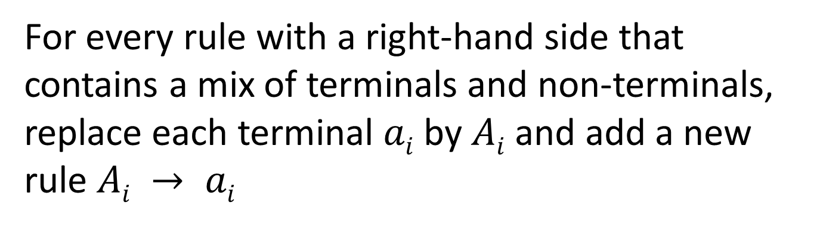
Step 1: replace terminals mixed in with non-terminals
For every rule with a right-hand side that contains a mix of terminals and non-terminals, replace each terminal $ai$ by $Ai$ and add a new rule $Ai → ai$
Q → aP
Q → A₁P
A₁ → a
Step 1

Slide 43
Example
S → AB
A → aCa
A → a
B → bB
B → b
C → D
D → d
S → AB
A → A₁CA₁
A → a
B → B₁B
B → b
C → D
D → d
A₁ → a
B₁ → b
Step 1
Replace the right-hand side, aCa, by A₁CA₁ and then add a new rule A₁ → a
Replace the right-hand side, bB, by B₁B and then add a new rule B₁ → b

Slide 44
Step 2: convert sequence of non-terminals to pairs of non-terminals
For every rule with a right-hand side that contains 3 or more non-terminals, replace all non-terminals but the first by X_{i} and then add a new rule where X_{i} has as its right-hand side those non-terminals that were replaced by X_{i}
Repeatedly apply Step 2 until there are no rules with more than two non-terminals on the right-hand side.
Q → ABCDE
Q → AX₁
X₁ → BX₂
X₂ → CX₃
X₃ → DE
Step 2

Slide 45
Repeatedly apply step 2
Q → ABCDE
Q → AX₁
X₁ → BCDE
Q → AX₁
X₁ → BX₂
X₂ → CDE
Step 2
Step 2
Step 2
Q → AX₁
X₁ → BX₂
X₂ → CX₃
X₃ → DE

Slide 46
Applying step 2 to a grammar
S → AB
A → A₁CA₁
A → a
B → B₁B
B → b
C → D
D → d
A₁ → a
B₁ → b
S → AB
A → A₁X₁
A → a
B → B₁B
B → b
C → D
D → d
A₁ → a
B₁ → b
X₁ → CA₁
Step 2
Replace the right-hand side, A₁CA₁, by A₁X₁ and then add a new rule X₁ → CA₁

Slide 47
3 kinds of rules remain
After performing steps 1 and 2, the resulting grammar has three kinds of rules:
  X → a
  X → Y
  X → YZ

Slide 48
Rules of the form: X → a
  X → a
  X → Y
  X → YZ
S → AB
A → A₁X₁
A → a
B → B₁B
B → b
C → D
D → d
A₁ → a
B₁ → a
X₁ → CA₁

Slide 49
Rules of the form: X → Y
  X → a
  X → Y
  X → YZ
S → AB
A → A₁X₁
A → a
B → B₁B
B → b
C → D
D → d
A₁ → a
B₁ → a
X₁ → CA₁

Slide 50
Rules of the form: X → YZ
  X → a
  X → Y
  X → YZ
S → AB
A → A₁X₁
A → a
B → B₁B
B → b
C → D
D → d
A₁ → a
B₁ → a
X₁ → CA₁

Slide 51
Chain rules
Rules with the form X → Y are called chain rules.

Slide 52
Chain rules aren’t in
Chomsky Normal Form
Recall the definition of Chomsky Normal Form:
  A context-free grammar is in Chomsky Normal Form if each rule has one of these forms:
    X → a
    X → YZ
Chain rules are of this form: X → Y
Clearly that is not Chomsky Normal Form.
So we must transform chain rules into the desired form.

Slide 53
Step 3: remove chain rules
Consider this chain rule:
X → Y
From the previous few slides we know that the rule for Y must have one of these forms:
    Y → a
    Y → Z
    Y → YZ
If there is a rule Y → a then replace X → Y by
X → a
If there is a rule Y → YZ then replace X → Y by
X → YZ
If there is a rule Y → Z then replace X → Y by the result of replacing Z (recursive definition – cool!)

Slide 54
Example
S → AB
A → A_{i}X_{i}
A → a
B → B_{i}B
B → b
C → D
D → d
A_{i} → a
B_{i} → a
X_{i} → CA_{i}
S → AB
A → A_{i}X_{i}
A → a
B → B_{i}B
B → b
C → d
D → d
A_{i} → a
B_{i} → a
X_{i} → CA_{i}
Step 3
Chomsky Normal Form
There is one chain rule: C → D
D is defined by this rule: D → d
So, replace the chain rule with: C → d

Slide 55
Another example
S → A
A → B
B → b
S → b
A → b
B → b
Step 3
This is a chain rule: S → A
A is defined by this chain rule: A → B
B is defined by this rule: B → b
So, replace the first chain rule with: S → b
And, replace the second chain rule with: A → b

Slide 56
Multiple rules may be generated
Consider this rule:
X → Y
The rule for Y may be an alternative:
Y → a | Z | AB
So the rule for X must be replaced by:
X → a
X → AB
plus the rule(s) generated by replacing Z

Slide 57
Recap
Using the 3-step process we can transform any ε-free context-free grammar into an equivalent grammar in Chomsky Normal Form.
Context-free grammar
Context-free grammar
in Chomsky Normal Form
3-step
transform

Slide 58
Grammars in Chomsky Normal Form produce binary trees
Each production tree that is created from a grammar in Chomsky Normal Form is a binary tree.
As we’ve discussed, lots is known about binary trees.

Slide 59
Objective
This mini-tutorial will answer these questions:
  What is Chomsky Normal Form?
    A context-free grammar is in Chomsky Normal Form if each rule has one of these forms:
      X → a
      X → YZ
  Why is Chomsky Normal Form useful/relevant?
    The production trees for grammars in Chomsky Normal Form are binary trees. Binary trees are well-studied. The results from research on binary trees can be applied to grammars in Chomsky Normal Form.
  How can arbitrary context-free grammars be converted to Chomsky Normal Form?
    Use the 3-step process described in the previous slides.

Slide 60
Grammars generate languages
string-1
grammar
string-2
…
generates
string-n
The set of strings is called a language
The language generated by a grammar $G$ is denoted by: $L(G)$

Slide 61
This grammar generates a^{n}b^{n}
S → AX
S → AB
A → a
B → b
X → SB
ab
aabb
…
generates
aa…bb
Each string consists of as followed by an equal number of bs
grammar
(in Chomsky Normal Form)

Slide 62

Production tree for $aabb$
S
A
X
S
a
B
b
A
B
a
b
S → AX
S → AB
A → a
B → b
X → SB
generates
grammar
(in Chomsky Normal Form)
Notice that the production tree is a binary tree.

Slide 63
Chomsky Normal Form enables powerful results
Interesting questions about grammars can be answered when the grammars are in Chomsky Normal Form.

Slide 64
Interesting Question:
Is a string a member of the language?
grammar G
(in Chomsky Normal Form)
Is P a member
of the language generated by G?
string P
no
yes

Slide 65
Is aabb a member of a^{n}b^{n}?
S → AX
S → AB
A → a
B → b
X → SB
Is aabb a member
of the language generated by G?
aabb
no
yes

Slide 66
Is abb a member of a^{n}b^{n}?
S → AX
S → AB
A → a
B → b
X → SB
Is abb a member
of the language generated by G?
no
abb
yes

Slide 67
Another interesting question:
Number of production steps needed?
grammar G
(in Chomsky Normal Form)
How many steps are needed to generate P?
string P
?? steps

Slide 68
We will answer both questions
But we will answer the latter question first:
  How many steps are needed to produce string P?

Slide 69
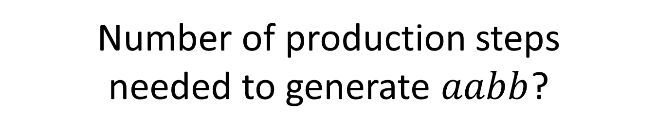
Number of production steps needed to generate $aabb$?
S
A
X
S
a
B
b
A
B
a
b
S → AX
S → AB
A → a
B → b
X → SB
1
generates
2
3
7
4
5
6

Slide 70
Number of production steps needed to generate $aabb$?
S → AX → aX → aSB → aABB → aaBB → aabB → aabb
1
2
3
4
5
6
7
7 steps needed to generate aabb

Slide 71
Calculate the number of steps based on string length
The following slides show how to calculate the number of production steps needed to generate a string.
The calculation will be based on the length of the string.

Slide 72
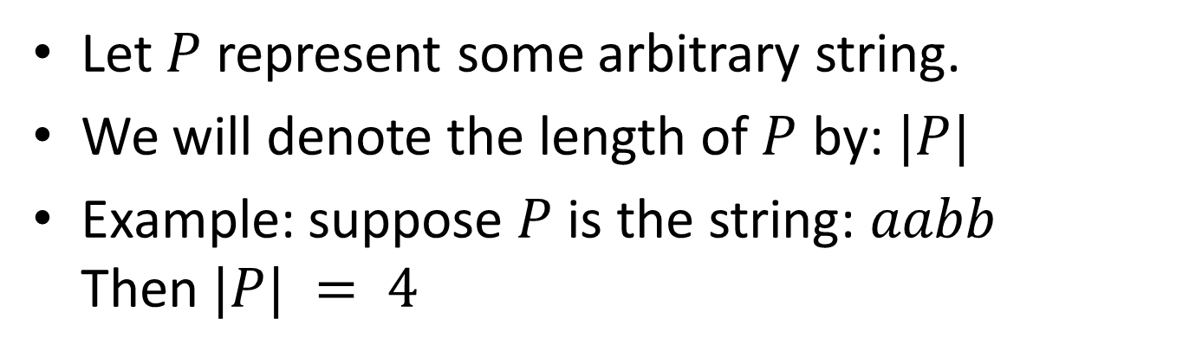
Notation for “length of a string”
Let $P$ represent some arbitrary string.
We will denote the length of $P$ by: $|P|$
Example: suppose $P$ is the string: $aabb$
Then $|P| = 4$

Slide 73
Generate 1 symbol takes 1 step
S
a
S → a
generates
1

Slide 74
Generate 2 symbols takes 3 steps
S
A
B
a
b
S → AB
A → a
B → b
1
generates
2
3

Slide 75
One grammar
S → AB
A → a
B → b
This grammar generates only two symbols.
S → X
X → AB
A → a
B → b
How about this grammar? It also generates only two symbols. True, but it is not in Chomsky Normal Form. Namely, the first rule is not in Chomsky Normal Form.

Slide 76
Generate 3 symbols takes 5 steps
S
A
X
A
a
a
B
b
S → AX
S → AB
A → a
B → b
X → AB
1
generates
2
3
4
5

Slide 77
Generate 4 symbols takes 7 steps
S
A
X
S
a
A
B
b
B
a
b
S → AX
S → AB
A → a
B → b
X → SB
1
generates
2
3
7
4
5
6

Slide 78
Every non-terminal has one of these forms
A
a
A
B
C
A → a
A → BC

Slide 79
Remove the terminal symbols
S
A
X
S
a
A
B
b
B
a
b
S
A
X
S
A
B
B
remove terminals

Slide 80
The result is a full binary tree
S
A
X
S
A
B
B

Slide 81
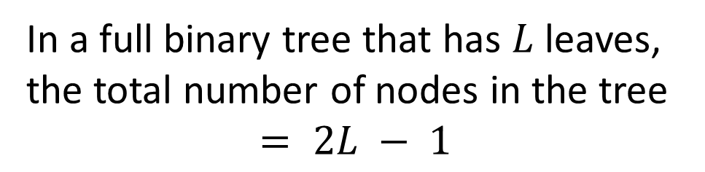
Recall this:
Number of nodes in a full binary tree
In a full binary tree that has $L$ leaves,
the total number of nodes in the tree
$$= 2L − 1$$

Slide 82
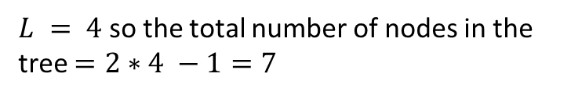
Number of nodes
S
A
X
S
A
B
B
$L = 4$ so the total number of nodes in the tree $=2∗4 −1=7$

Slide 83

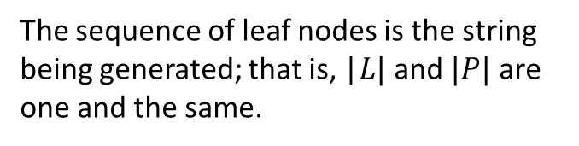
$L$ leaf nodes equals $|P|$
If a tree has $L$ leaf nodes, the total number of nodes in the tree $= 2L − 1$
The sequence of leaf nodes is the string being generated; that is, |$L|$ and $|P|$ are one and the same.

Slide 84
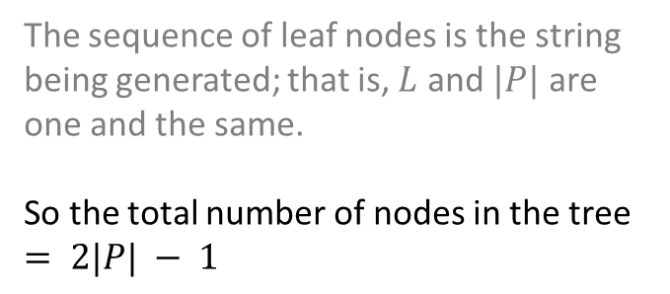
$L$ leaf nodes equals $|P|$
If the tree has $L$ leaves, the total number of nodes in the tree $= 2L − 1$
The sequence of leaf nodes is the string being generated; that is, $L$ and $|P|$ are one and the same.
So the total number of nodes in the tree $= 2|P| − 1$

Slide 85
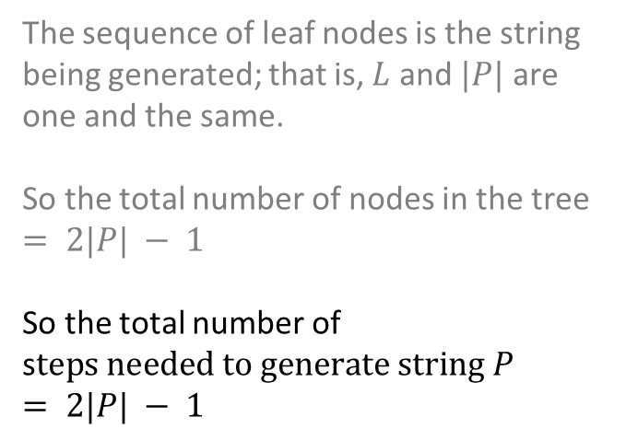
$L$ leaf nodes equals $|P|$
If the tree has $L$ leaves, the total number of nodes in the tree $= 2L − 1$
The sequence of leaf nodes is the string being generated; that is, $L$ and $|P|$ are one and the same.
So the total number of nodes in the tree $= 2|P| − 1$
So the total number of s$teps needed to generate string P$
$$= 2|P| − 1$$

Slide 86
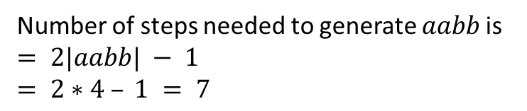
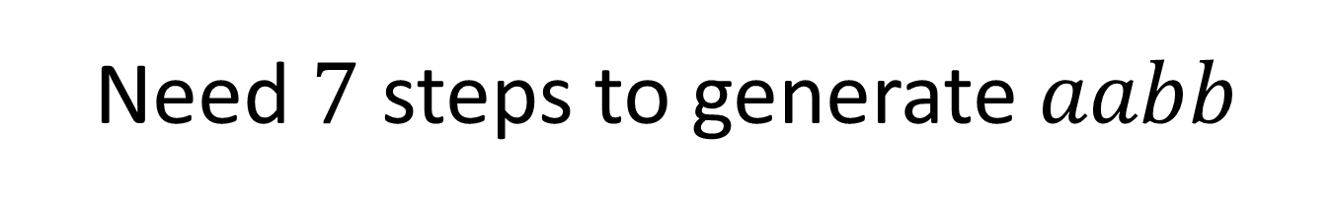
Need $7$ steps to generate $aabb$
S
A
X
S
a
A
B
b
B
a
b
Number of steps needed to generate $aabb \text{is}$
$= 2|aabb| − 1$
$$= 2∗4 – 1 = 7$$

Slide 87
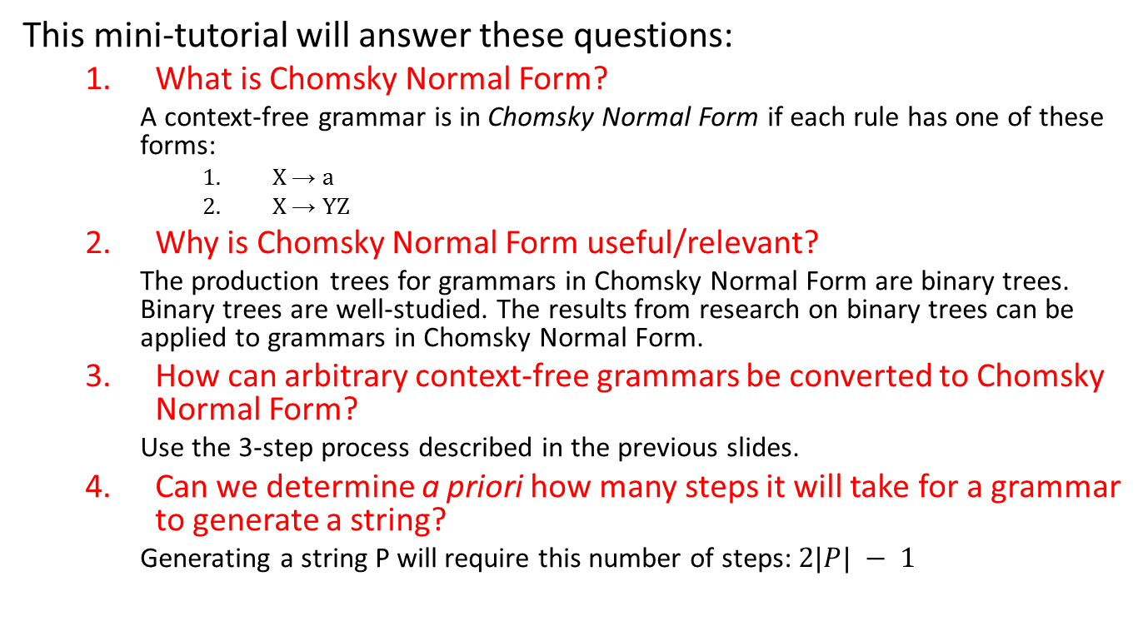
Objective
This mini-tutorial will answer these questions:
  What is Chomsky Normal Form?
    A context-free grammar is in Chomsky Normal Form if each rule has one of these forms:
      X → a
      X → YZ
  Why is Chomsky Normal Form useful/relevant?
    The production trees for grammars in Chomsky Normal Form are binary trees. Binary trees are well-studied. The results from research on binary trees can be applied to grammars in Chomsky Normal Form.
  How can arbitrary context-free grammars be converted to Chomsky Normal Form?
    Use the 3-step process described in the previous slides.
  Can we determine a priori how many steps it will take for a grammar to generate a string?
    Generating a string P will require this number of steps: $2|P| − 1$

Slide 88
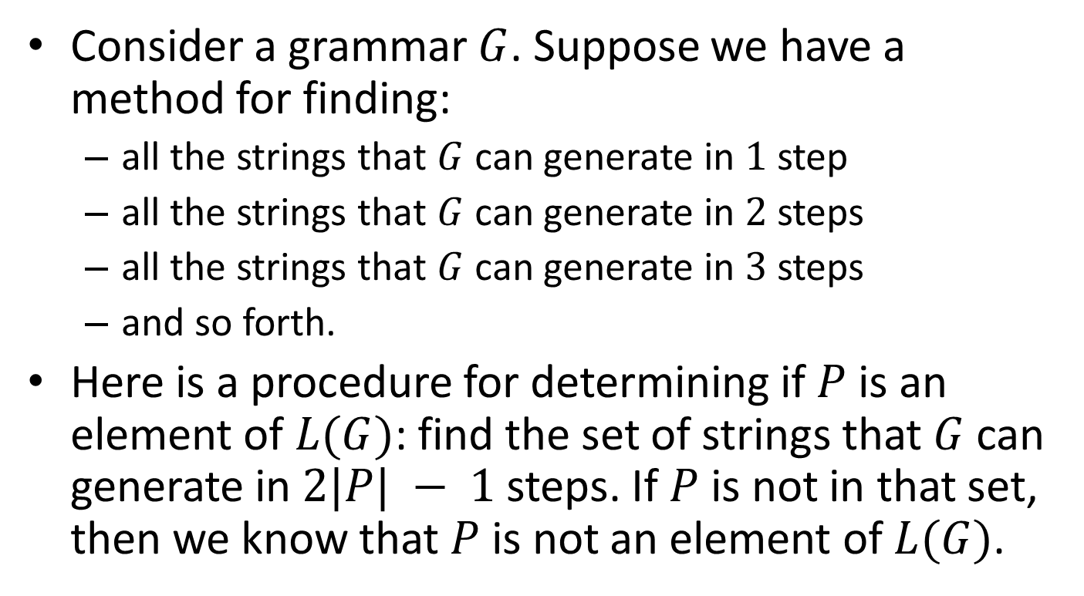
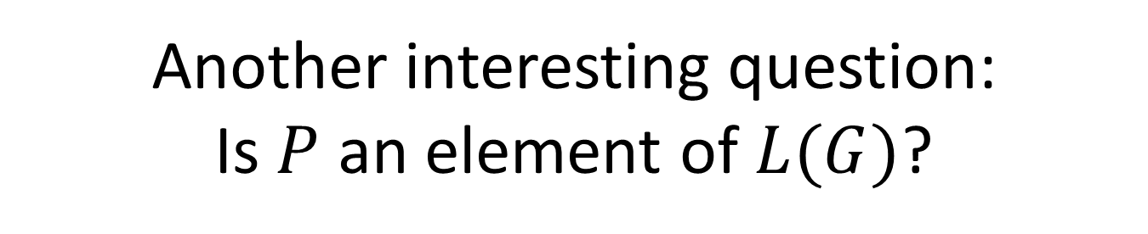
Another interesting question:
Is $P$ an element of $L(G)$?
Consider a grammar $G$. Suppose we have a method for finding:
  all the strings that $G$ can generate in $1$ step
  all the strings that $G$ can generate in $2$ steps
  all the strings that $G$ can generate in $3$ steps
  and so forth.
Here is a procedure for determining if $P$ is an element of $L(G)$: find the set of strings that $G$ can generate in $2|P| − 1$steps. If $P$ is not in that set, then we know that $P$ is not an element of $L(G)$.

Slide 89
CF grammar, G
A procedure exists for deciding if a string P is an element of G’s language!
Create a set of all the strings that can be generated from G
in 2|P| - 1 steps
string P
set w
Is P an element of w?
No
P ∉ L(G)
P ∈ L(G)

Slide 90
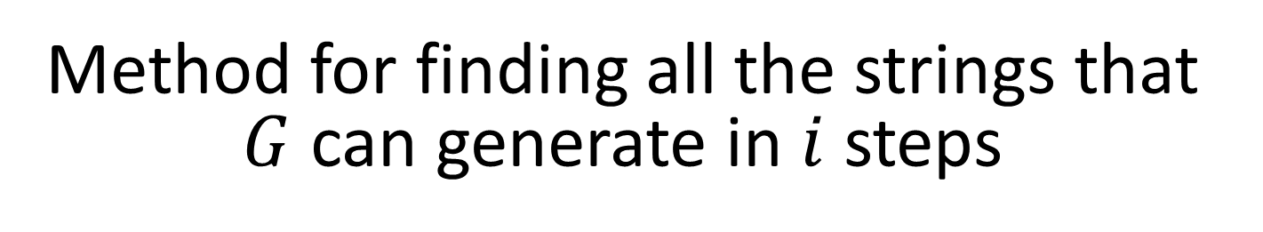
Method for finding all the strings that $G$ can generate in $i$ steps
Queue
AB
S
S
substitute S
S → AB
A → a
B → b
We can systematically generate all strings using a queue.

Slide 91
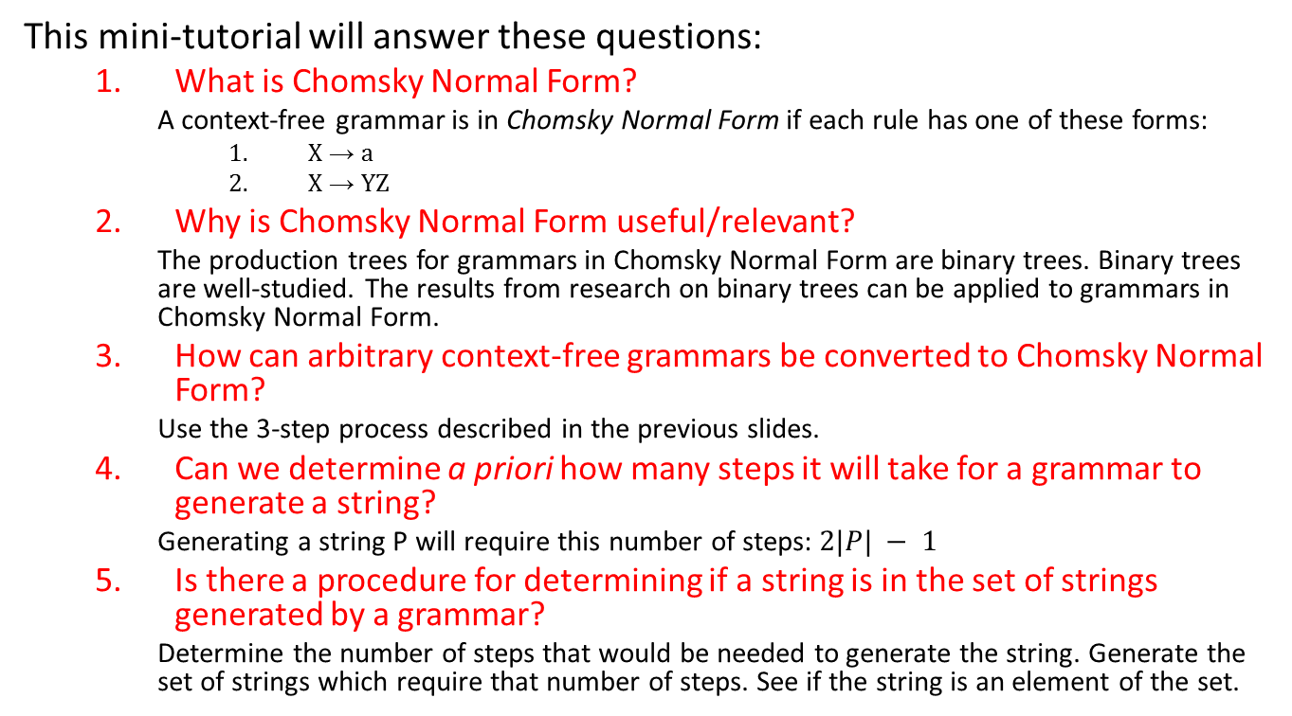
Objective
This mini-tutorial will answer these questions:
  What is Chomsky Normal Form?
    A context-free grammar is in Chomsky Normal Form if each rule has one of these forms:
      X → a
      X → YZ
  Why is Chomsky Normal Form useful/relevant?
    The production trees for grammars in Chomsky Normal Form are binary trees. Binary trees are well-studied. The results from research on binary trees can be applied to grammars in Chomsky Normal Form.
  How can arbitrary context-free grammars be converted to Chomsky Normal Form?
    Use the 3-step process described in the previous slides.
  Can we determine a priori how many steps it will take for a grammar to generate a string?
    Generating a string P will require this number of steps: $2|P| − 1$
  Is there a procedure for determining if a string is in the set of strings generated by a grammar?
    Determine the number of steps that would be needed to generate the string. Generate the set of strings which require that number of steps. See if the string is an element of the set.

Slide 92
Case Study
We are tasked to generate data for Books in a BookStore.
The Genre of a Book is either fiction or non-fiction.
The Publisher of a Book is either Springer, MIT Press, or Harvard Press.
The Title of a Book is either “The Wisdom of Crowds,” “Six Great Ideas,” or “Society of Mind.”
Create a grammar that generates strings containing the title of a book, its genre, and its publisher.

Slide 93
BookStore Grammar
Bookstore
Bookstore
Book
Title
Title
Title
Genre
Genre
Publisher
Publisher
Publisher
→
→
→
→
→
→
→
→
→
→
→
Book Bookstore
Book
Title Genre Publisher
“Wisdom of Crowds”
“Six Great Ideas”
“Society of Mind”
“fiction”
“non-fiction”
“Springer”
“MIT Press”
“Harvard Press”

Slide 94
Not in Chomsky Normal Form
chain rule
Bookstore
Bookstore
Book
Title
Title
Title
Genre
Genre
Publisher
Publisher
Publisher
→
→
→
→
→
→
→
→
→
→
→
Book Bookstore
Book
Title Genre Publisher
“Wisdom of Crowds”
“Six Great Ideas”
“Society of Mind”
“fiction”
“non-fiction”
“Springer”
“MIT Press”
“Harvard Press”
too many non-terminals on right-hand side

Slide 95
Transform to Chomsky Normal Form
Bookstore
Bookstore
Book
Title
Title
Title
Genre
Genre
Publisher
Publisher
Publisher
→
→
→
→
→
→
→
→
→
→
→
Book Bookstore
Book
Title Genre Publisher
“Wisdom of Crowds”
“Six Great Ideas”
“Society of Mind”
“fiction”
“non-fiction”
“Springer”
“MIT Press”
“Harvard Press”
Bookstore
Bookstore
Book
Other
Title
Title
Title
Genre
Genre
Publisher
Publisher
Publisher
→
→
→
→
→
→
→
→
→
→
→
→
Book Bookstore
Title Other
Title Other
Genre Publisher
“Wisdom of Crowds”
“Six Great Ideas”
“Society of Mind”
“fiction”
“non-fiction”
“Springer”
“MIT Press”
“Harvard Press”
transform
Chomsky Normal Form

Slide 96
How many production steps needed to generate this data?
Wisdom of Crowds non-fiction Springer Society of Mind non-fiction Harvard Press

Slide 97
Determine the length of the data
Wisdom of Crowds non-fiction Springer Society of Mind non-fiction Harvard Press
1 2 3 4 5 6

Slide 98
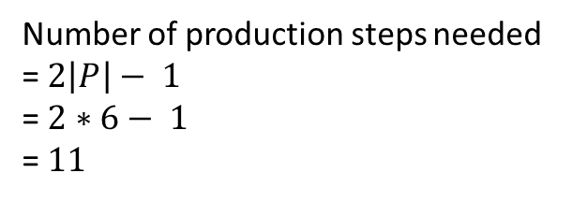
Calculate the answer
Wisdom of Crowds non-fiction Springer Society of Mind non-fiction Harvard Press
1 2 3 4 5 6
    Number of production steps needed
    = $2\left|P\right|− 1$
    = $2∗6− 1$
    = $11$

Slide 99
Check the results
Bookstore
Bookstore
Book
Other
Title
Title
Title
Genre
Genre
Publisher
Publisher
Publisher
→
→
→
→
→
→
→
→
→
→
→
→
Book Bookstore
Title Other
Title Other
Genre Publisher
“Wisdom of Crowds”
“Six Great Ideas”
“Society of Mind”
“fiction”
“non-fiction”
“Springer”
“MIT Press”
“Harvard Press”
Bookstore
Book
Bookstore
Title
Title
Other
Society of Mind
Genre
Other
Genre
Publisher
Wisdom of Crowds
non-fiction
Springer
Publisher
non-fiction
Harvard Press
1
2
7
3
9
4
8
5
6
10
11

Slide 100
XML, XML Schema
If the Bookstore grammar is converted into an XML Schema, how many XML elements will be needed to markup this data:
Wisdom of Crowds non-fiction Springer Society of Mind non-fiction Harvard Press

Slide 101
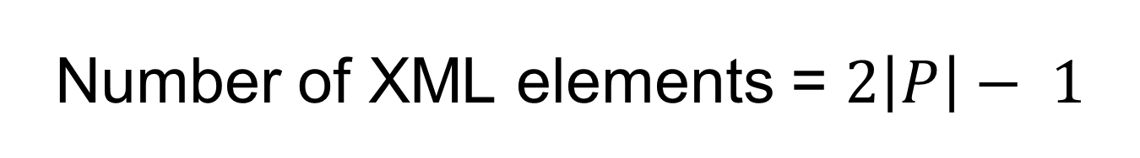
    Number of XML elements = $2\left|P\right|− 1$
1
<Bookstore>
<Book>
<Title>Wisdom of Crowds</Title>
<Other>
<Genre>non-fiction</Genre>
<Publisher>Springer</Publisher>
</Other>
</Book>
<Bookstore>
<Title>Society of Mind</Title>
<Other>
<Genre>non-fiction</Genre>
<Publisher>Harvard Press</Publisher>
</Other>
</Bookstore>
</Bookstore>
2
3
4
5
6
7
8
9
10
11

Slide 102
Bookstore XML Schema
<xs:schema xmlns:xs="http://www.w3.org/2001/XMLSchema">
<xs:element name="Document">
<xs:complexType>
<xs:sequence>
<xs:element ref="Bookstore" />
</xs:sequence>
</xs:complexType>
</xs:element>
<xs:element name="Bookstore">
<xs:complexType>
<xs:choice>
<xs:sequence>
<xs:element ref="Book" />
<xs:element ref="Bookstore" />
</xs:sequence>
<xs:sequence>
<xs:element ref="Title" />
<xs:element ref="Other" />
</xs:sequence>
</xs:choice>
</xs:complexType>
</xs:element>
<xs:element name="Book">
<xs:complexType>
<xs:sequence>
<xs:element ref="Title" />
<xs:element ref="Other" />
</xs:sequence>
</xs:complexType>
</xs:element>
<xs:element name="Title">
<xs:simpleType>
<xs:restriction base="xs:string">
<xs:enumeration value="Wisdom of Crowds" />
<xs:enumeration value="Six Great Ideas" />
<xs:enumeration value="Society of Mind" />
</xs:restriction>
</xs:simpleType>
</xs:element>

Slide 103
Bookstore XML Schema
<xs:element name="Other">
<xs:complexType>
<xs:sequence>
<xs:element ref="Genre" />
<xs:element ref="Publisher" />
</xs:sequence>
</xs:complexType>
</xs:element>
<xs:element name="Genre">
<xs:simpleType>
<xs:restriction base="xs:string">
<xs:enumeration value="fiction" />
<xs:enumeration value="non-fiction" />
</xs:restriction>
</xs:simpleType>
</xs:element>
<xs:element name="Publisher">
<xs:simpleType>
<xs:restriction base="xs:string">
<xs:enumeration value="Springer" />
<xs:enumeration value="MIT Press" />
<xs:enumeration value="Harvard Press" />
</xs:restriction>
</xs:simpleType>
</xs:element>
</xs:schema>

